Slide 1

EE5003 Presentation
Artificial intelligence of things (AIoT) enabled e-vest for remote and convenient adolescent idiopathic scoliosis diagnosis
Fan Gaoyige
A032682E
fangaoyige@u.nus.edu
Supervisor: Prof. Lee Chengkuo
Examiner: Prof. John Ho

Slide 2
1. Project Background

Slide 3
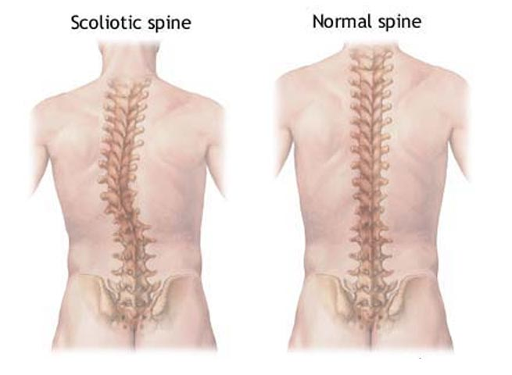
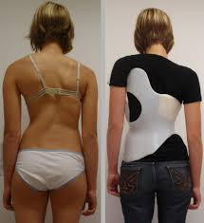
Adolescent Idiopathic Scoliosis
Adolescent Idiopathic Scoliosis (AIS) is a skeletal and muscular disorder of unknown etiology that occurs during preadolescence or before skeletal growth and maturation, mostly in females aged 10 to 18 years [1].
AIS can cause significant physical and psychological damage to the young person, with the most easily detectable and most concerning physical deformities.
Brace Therapy for AIS patients
Bracing has been used in the treatment of AIS for centuries. The goal of brace treatment for AIS is to halt the progression of a curve and to improve cosmetic appearance in accordance with maintaining whole body alignment and balance during a period of growth [2].
However, traditional brace therapy has limitation in dynamic evaluation of patient state.
[1] Negrini, Stefano, et al. "2016 SOSORT guidelines: orthopaedic and rehabilitation treatment of idiopathic scoliosis during growth." Scoliosis and spinal disorders 13.1 (2018): 1-48.
[2] W. J. Shaughnessy, “Advances in scoliosis brace treatment for adolescentidiopathic scoliosis”, Orthopedic Clinics of North America, vol. 38, no. 4, pp. 469–475, 2007.

Slide 4
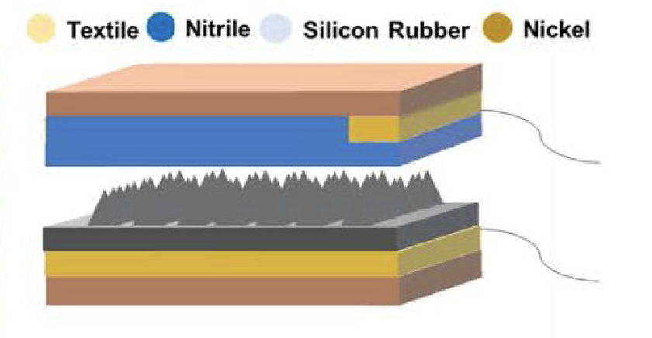
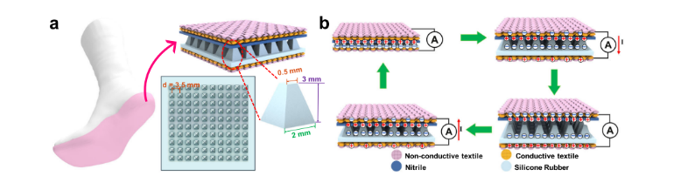
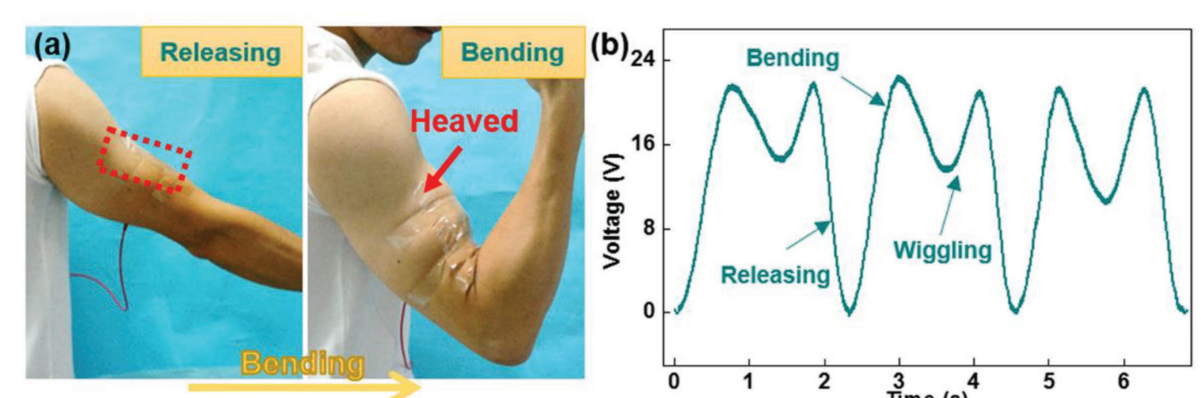
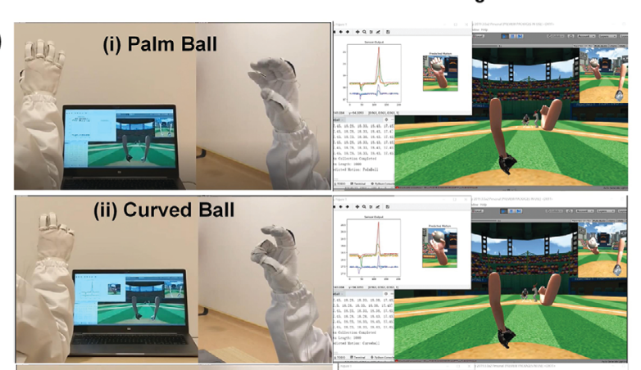
Triboelectric Nanogenerator
Since 2012, the triboelectric nanogenerator (TENG) has attracted considerable attention due to its high instantaneous output power, broad selection of available materials, eco-friendly and inexpensive fabrication process, and various working modes customized for target applications [1].
Zhang developed low-cost triboelectric intelligent socks for harvesting waste energy from low-frequency body motions to transmit wireless sensory data [2].
Wen proposed a soft TENG film to harvest energy from the stretch of limbs with advanced efficiency [3].
Wen designed a TENG enabled smart glove as an interface for detecting the motion of hands and implemented a baseball VR game with the gloves [4].
According to these applications, TENG has high sensitivity to motion, thus it is a perfect choice to work as a self-powered sensor for detecting dynamic posture in this project.
[1] S.-p. Neuroprosthetics, et al. “A Review and Perspective for the Development of Triboelectric Nanogenerator ( TENG ) -Based”, Micromachines, 2020.
[2] Z. Zhang et al., “Deep learning-enabled triboelectric smart socks for IoT-based gait analysis and VR applications,” npj Flex. Electron., vol. 4, no. 1, pp. 1–12, 2020
[3] F. Wen et al., “Machine Learning Glove Using Self-Powered Conductive Superhydrophobic Triboelectric Textile for Gesture Recognition in VR/AR Applications,” Adv. Sci., vol. 7, no. 14, pp. 1–15, 2020, doi: 10.1002/advs.202000261.
[4] Z. Wen et al., “A Wrinkled PEDOT:PSS Film Based Stretchable and Transparent Triboelectric Nanogenerator for Wearable Energy Harvesters and Active Motion Sensors,” Adv. Funct. Mater., vol. 28, no. 37, Sep. 2018

Slide 5
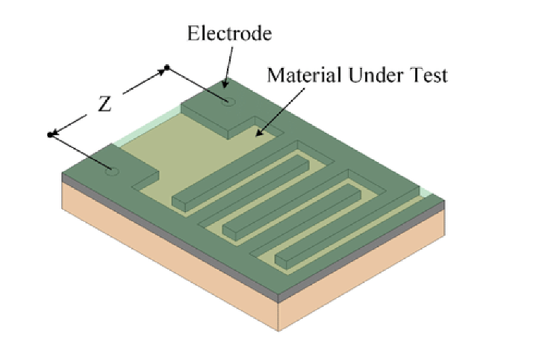
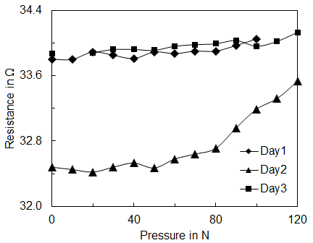
Interdigitated Electrode
Despite the advanced sensitivity to motion, TENG has weak capability to detect static posture like sit, stand, etc.
Recently, interdigital electrodes are widely used in acoustic sensing area owing to its sensitivity to different frequencies. But the interdigital electrode array structure also has the potential to work as pressure sensor. While the pressure exerted increasing, the resistance of the sensor keeps pace with the pressure [1].
By sensing the variance of resistance, the interdigital electrodes can work as pressure sensor. In this project, owing to its low cost and thin thickness, can be use as a supplement for sensing.
[1] Ramalingame, Rajarajan, et al. "Influence of electrode design for temperature and pressure sensing behavior of flexible and bio-compatible nanocomposites." 2016 Nanotechnology for Instrumentation and Measurement (NANOfIM). IEEE, 2016.

Slide 6
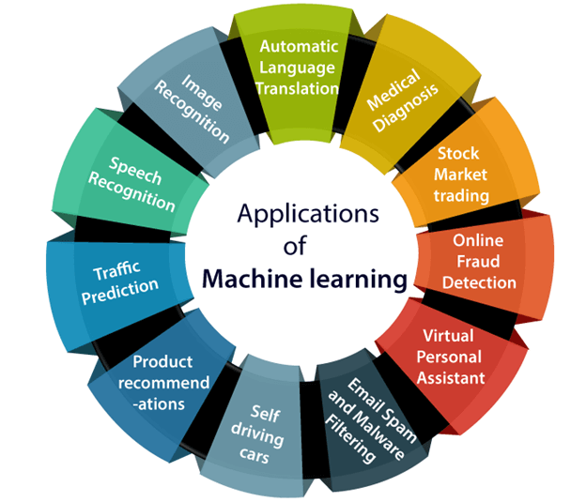
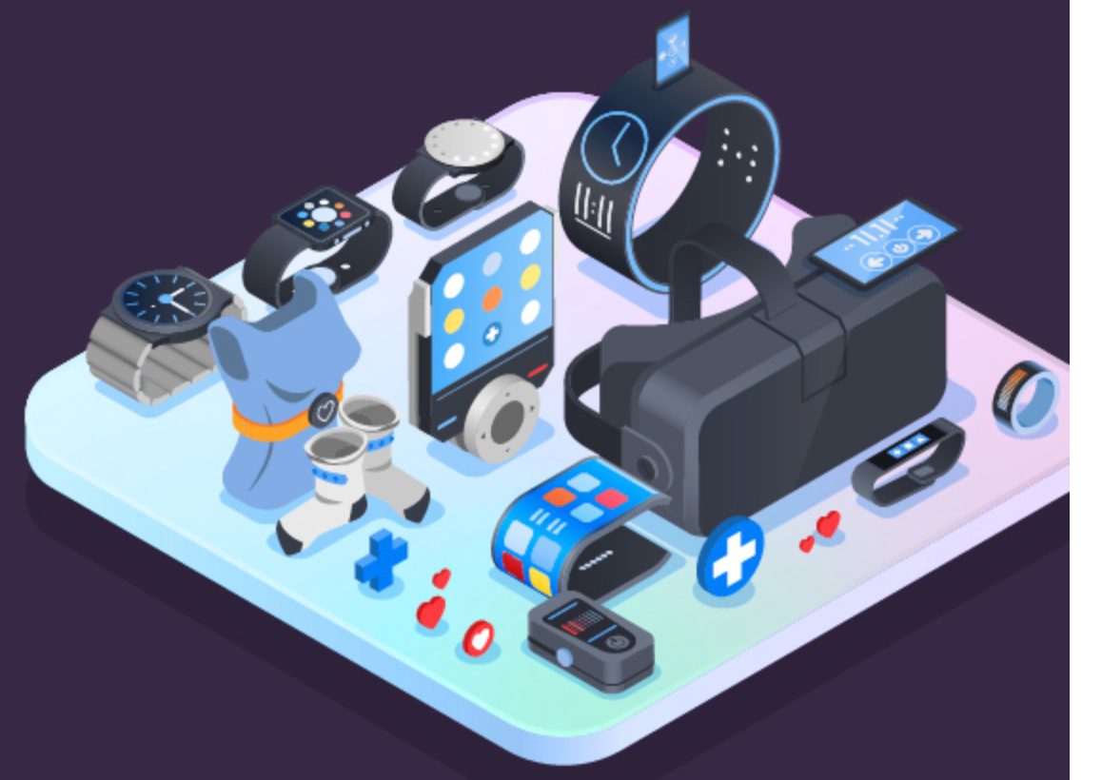
Machine Learning
Machine learning, as an emerging technology [1], has strong potential to extract subtle differences and processing complex data in different applications: gesture recognition[2], healthcare diagnose[3], ﻿keystroke dynamics identification[4], etc.
Thus, machine learning is a perfect solution for recognizing different postures and producing medical analysis in this project.
Artificial Intelligence of Thighs (AIoT)
The Internet of Things (IoT) is a technology helping us to reimagine daily life, but artificial intelligence (AI) is the real driving force behind the IoT’s full potential [5].
[1] Sidiropoulos, Nicholas D., et al. "Tensor decomposition for signal processing and machine learning." IEEE Transactions on Signal Processing 65.13 (2017): 3551-3582.
[2] F. Wen et al., “Machine Learning Glove Using Self-Powered Conductive Superhydrophobic Triboelectric Textile for Gesture Recognition in VR/AR Applications,” Adv. Sci., vol. 7, no. 14, pp. 1–15, 2020, doi: 10.1002/advs.202000261.
[3] J. Zhu, Z. Ren, and C. Lee, “Toward Healthcare Diagnoses by Machine- Learning-Enabled Volatile Organic Compound Identi fi cation,” 2020, doi: 10.1021/acsnano.0c07464.
[4] G. Zhao et al., “Keystroke Dynamics Identification Based on Triboelectric Nanogenerator for Intelligent Keyboard Using Deep Learning Method,” Adv. Mater. Technol., vol. 4, no. 1, Jan. 2019, doi: 10.1002/admt.201800167.
[5] Luo, Chunjie, et al. "AIoT bench: towards comprehensive benchmarking mobile and embedded device intelligence." International Symposium on Benchmarking, Measuring and Optimization. Springer, Cham, 2018.

Slide 7
2. Problem Statement

Slide 8
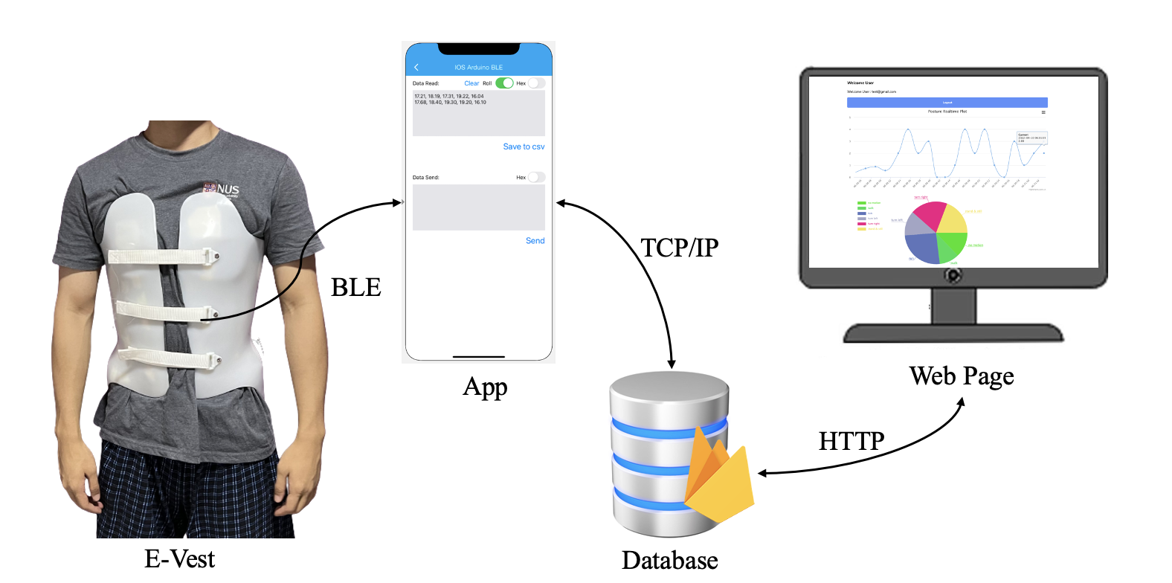
Problem Statement
Fabricate an E-Vest with sensors for AIS patients.
Implement posture recognition via machine learning
Provide a closed-loop solution to therapy for patients and doctors

Slide 9
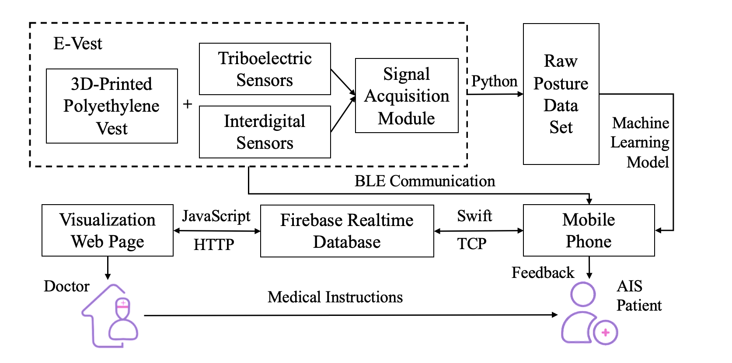
Project Structure

Slide 10
3. Front-End Design

Slide 11
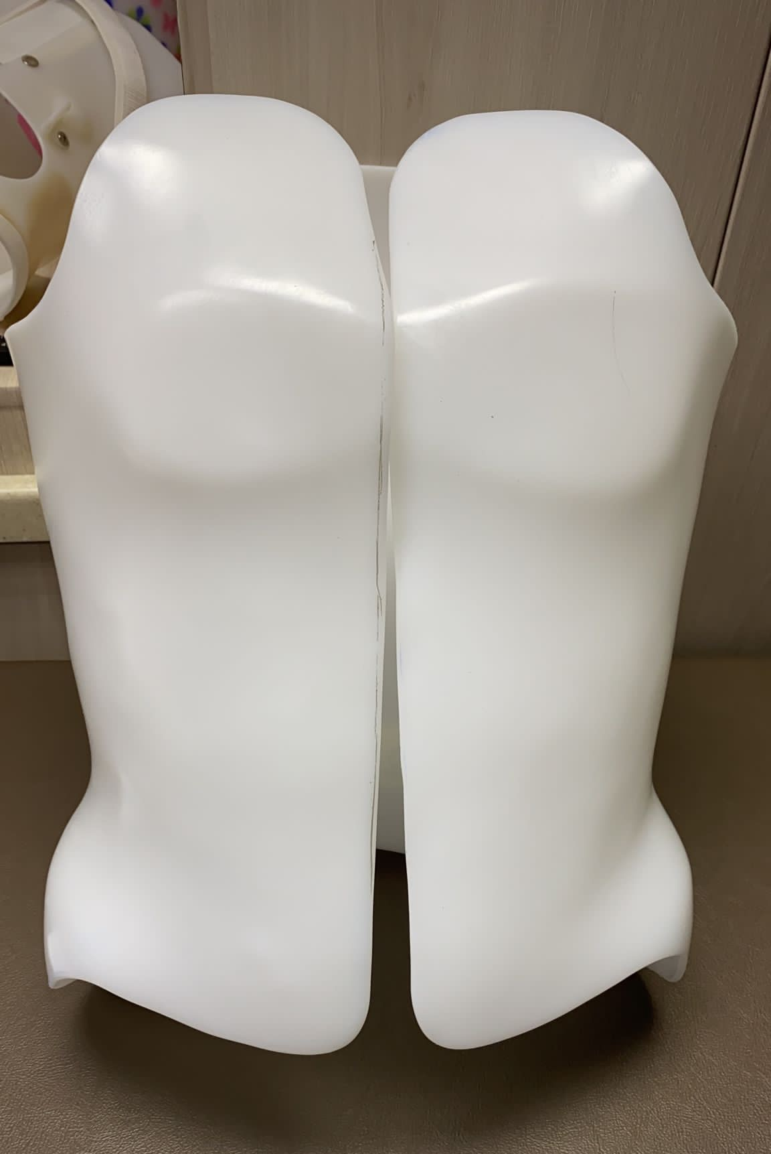
1. 3D-Printed Vest [1]
3D scan the body trunk and get a rough model.
Modified the 3D model by finite element analysis.
3D print the vest with Polyethylene (PE) material.
Add straps for adjusting the tightness.
[1] Fabricated by Dr. Lau from NUH in studio LIFEFORCE Limbs & Rehab Pte Ltd

Slide 12
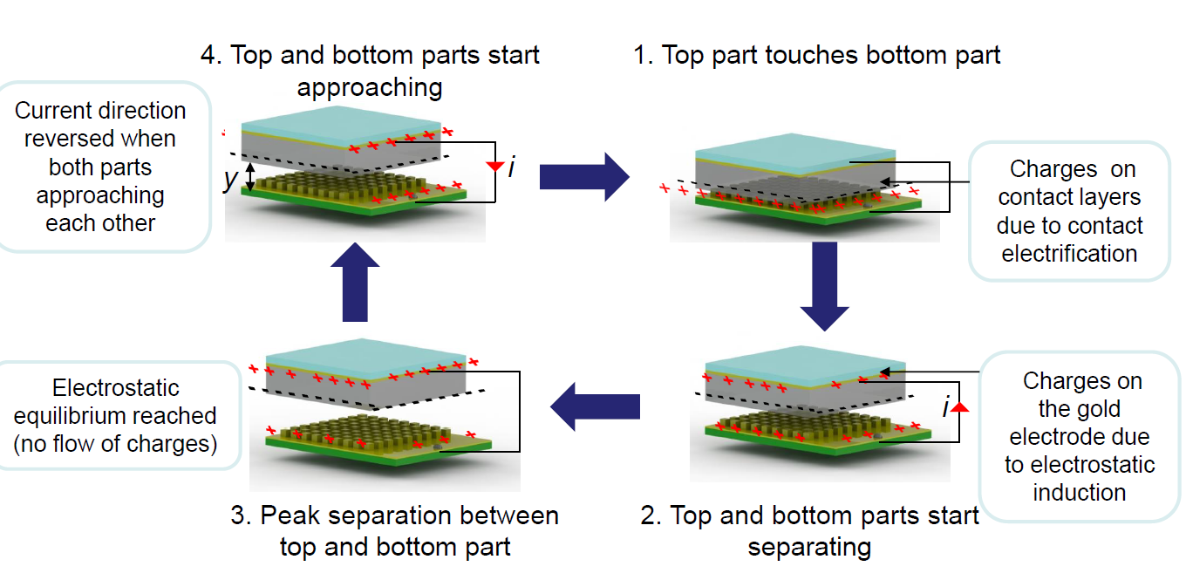
2. Triboelectric Sensor
a. Triboelectric Mechanism
In this operating cycle mechanical energy is converted into electrical energy when top and bottom parts are separated during step 2.

Slide 13
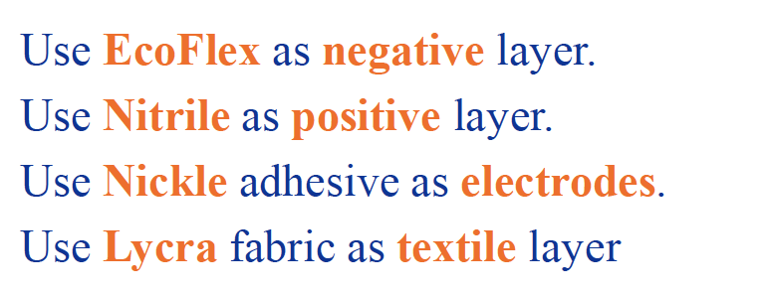
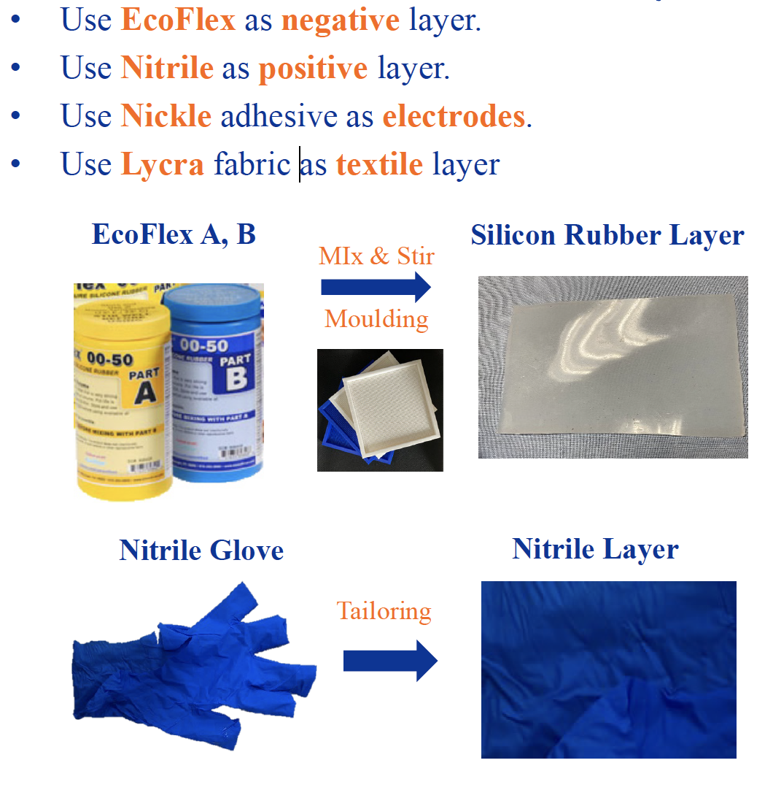
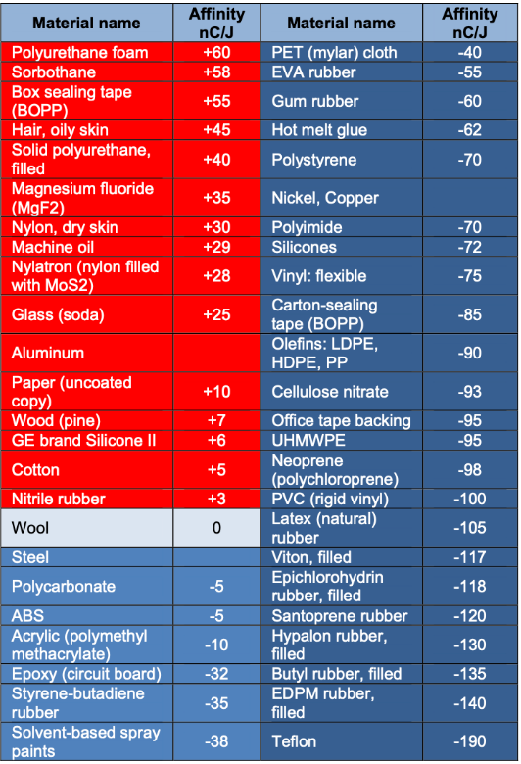
2. Triboelectric Sensor
b. Material Selection
[1] Molnar O , Gerasimov V , Kurytnik I P. Triboelectricity and construction of power generators based on it[J]. Przeglad Elektrotechniczny, 2018, 1(1):167-171.

Slide 14
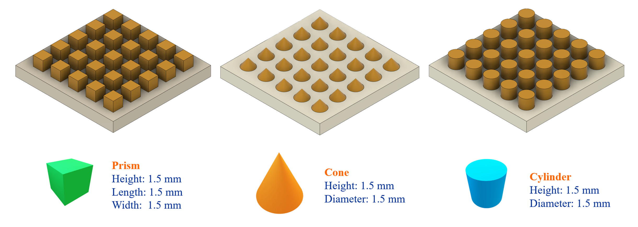
2. Triboelectric Sensor
c. Surface Feature
Wen’s group proposed a stretchable triboelectric sensor with wrinkles on the surface which strengthen the output of signal. According to this idea, I designed different bulges on silicone rubber layer as surface feature.
[1] Z. Wen et al., “A Wrinkled PEDOT:PSS Film Based Stretchable and Transparent Triboelectric Nanogenerator for Wearable Energy Harvesters and Active Motion Sensors,” Adv. Funct. Mater., vol. 28, no. 37, Sep. 2018, doi: 10.1002/adfm.201803684.

Slide 15
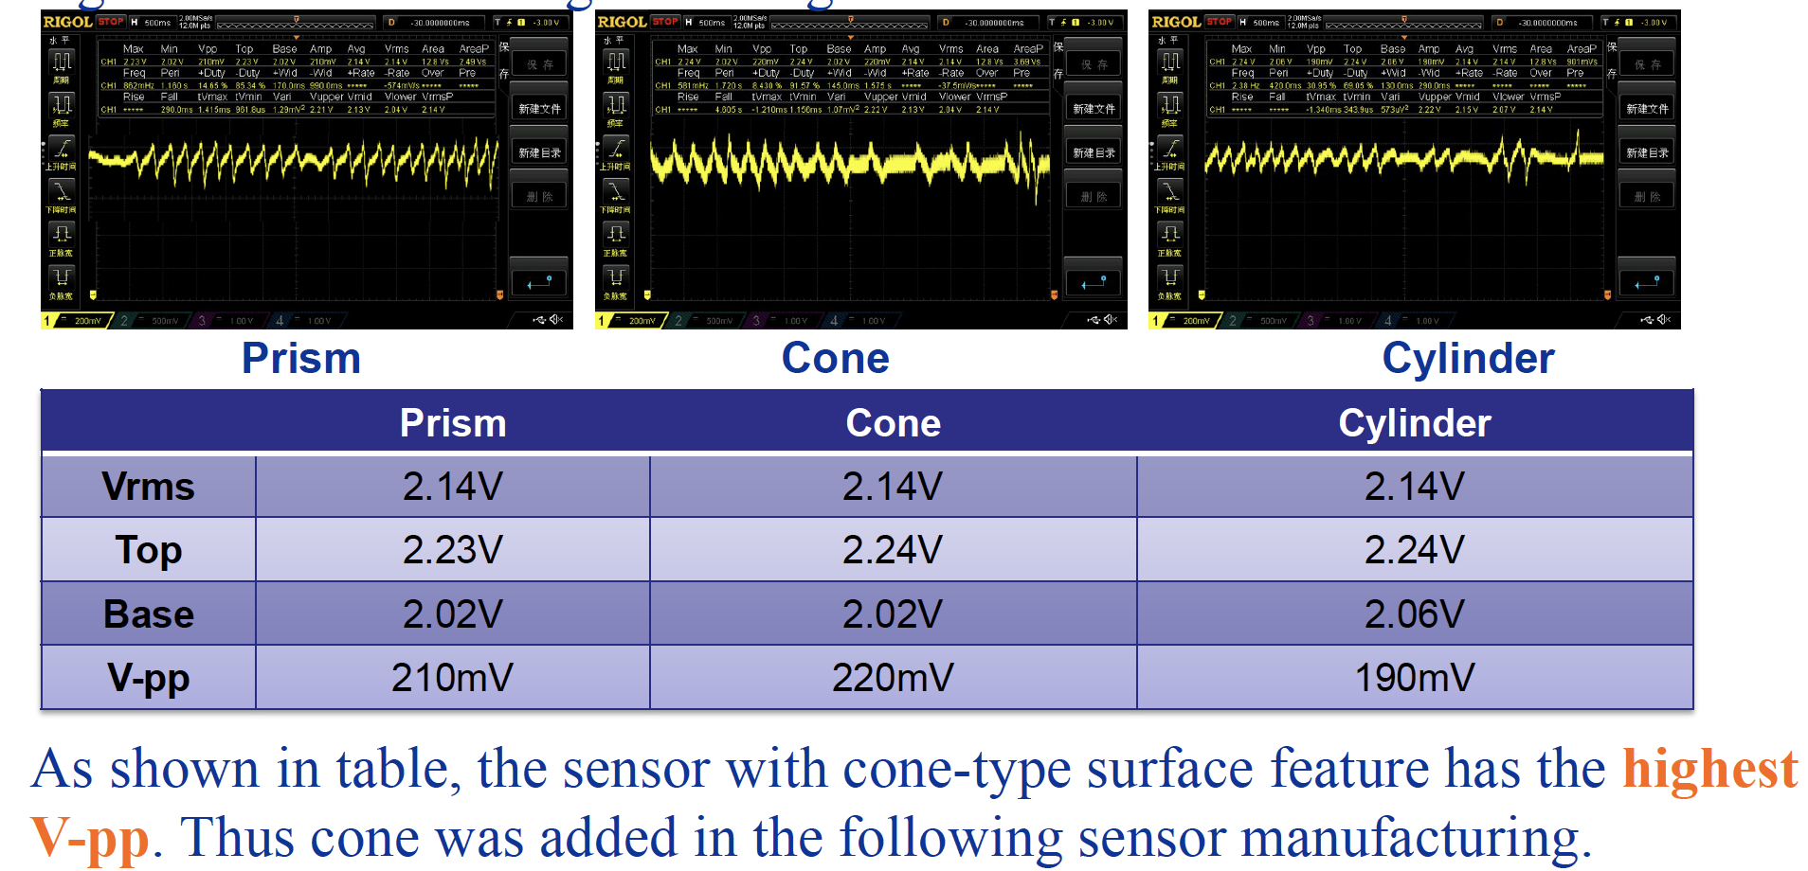
2. Triboelectric Sensor
Exert the equal force with same speed to test their analog signals. Here are the signal testing results:
c. Surface Feature

Slide 16
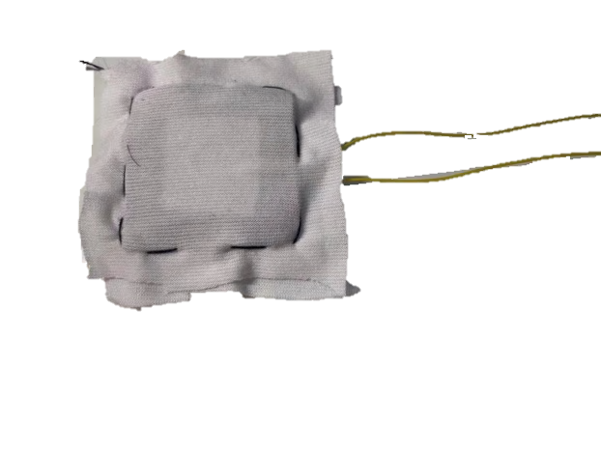
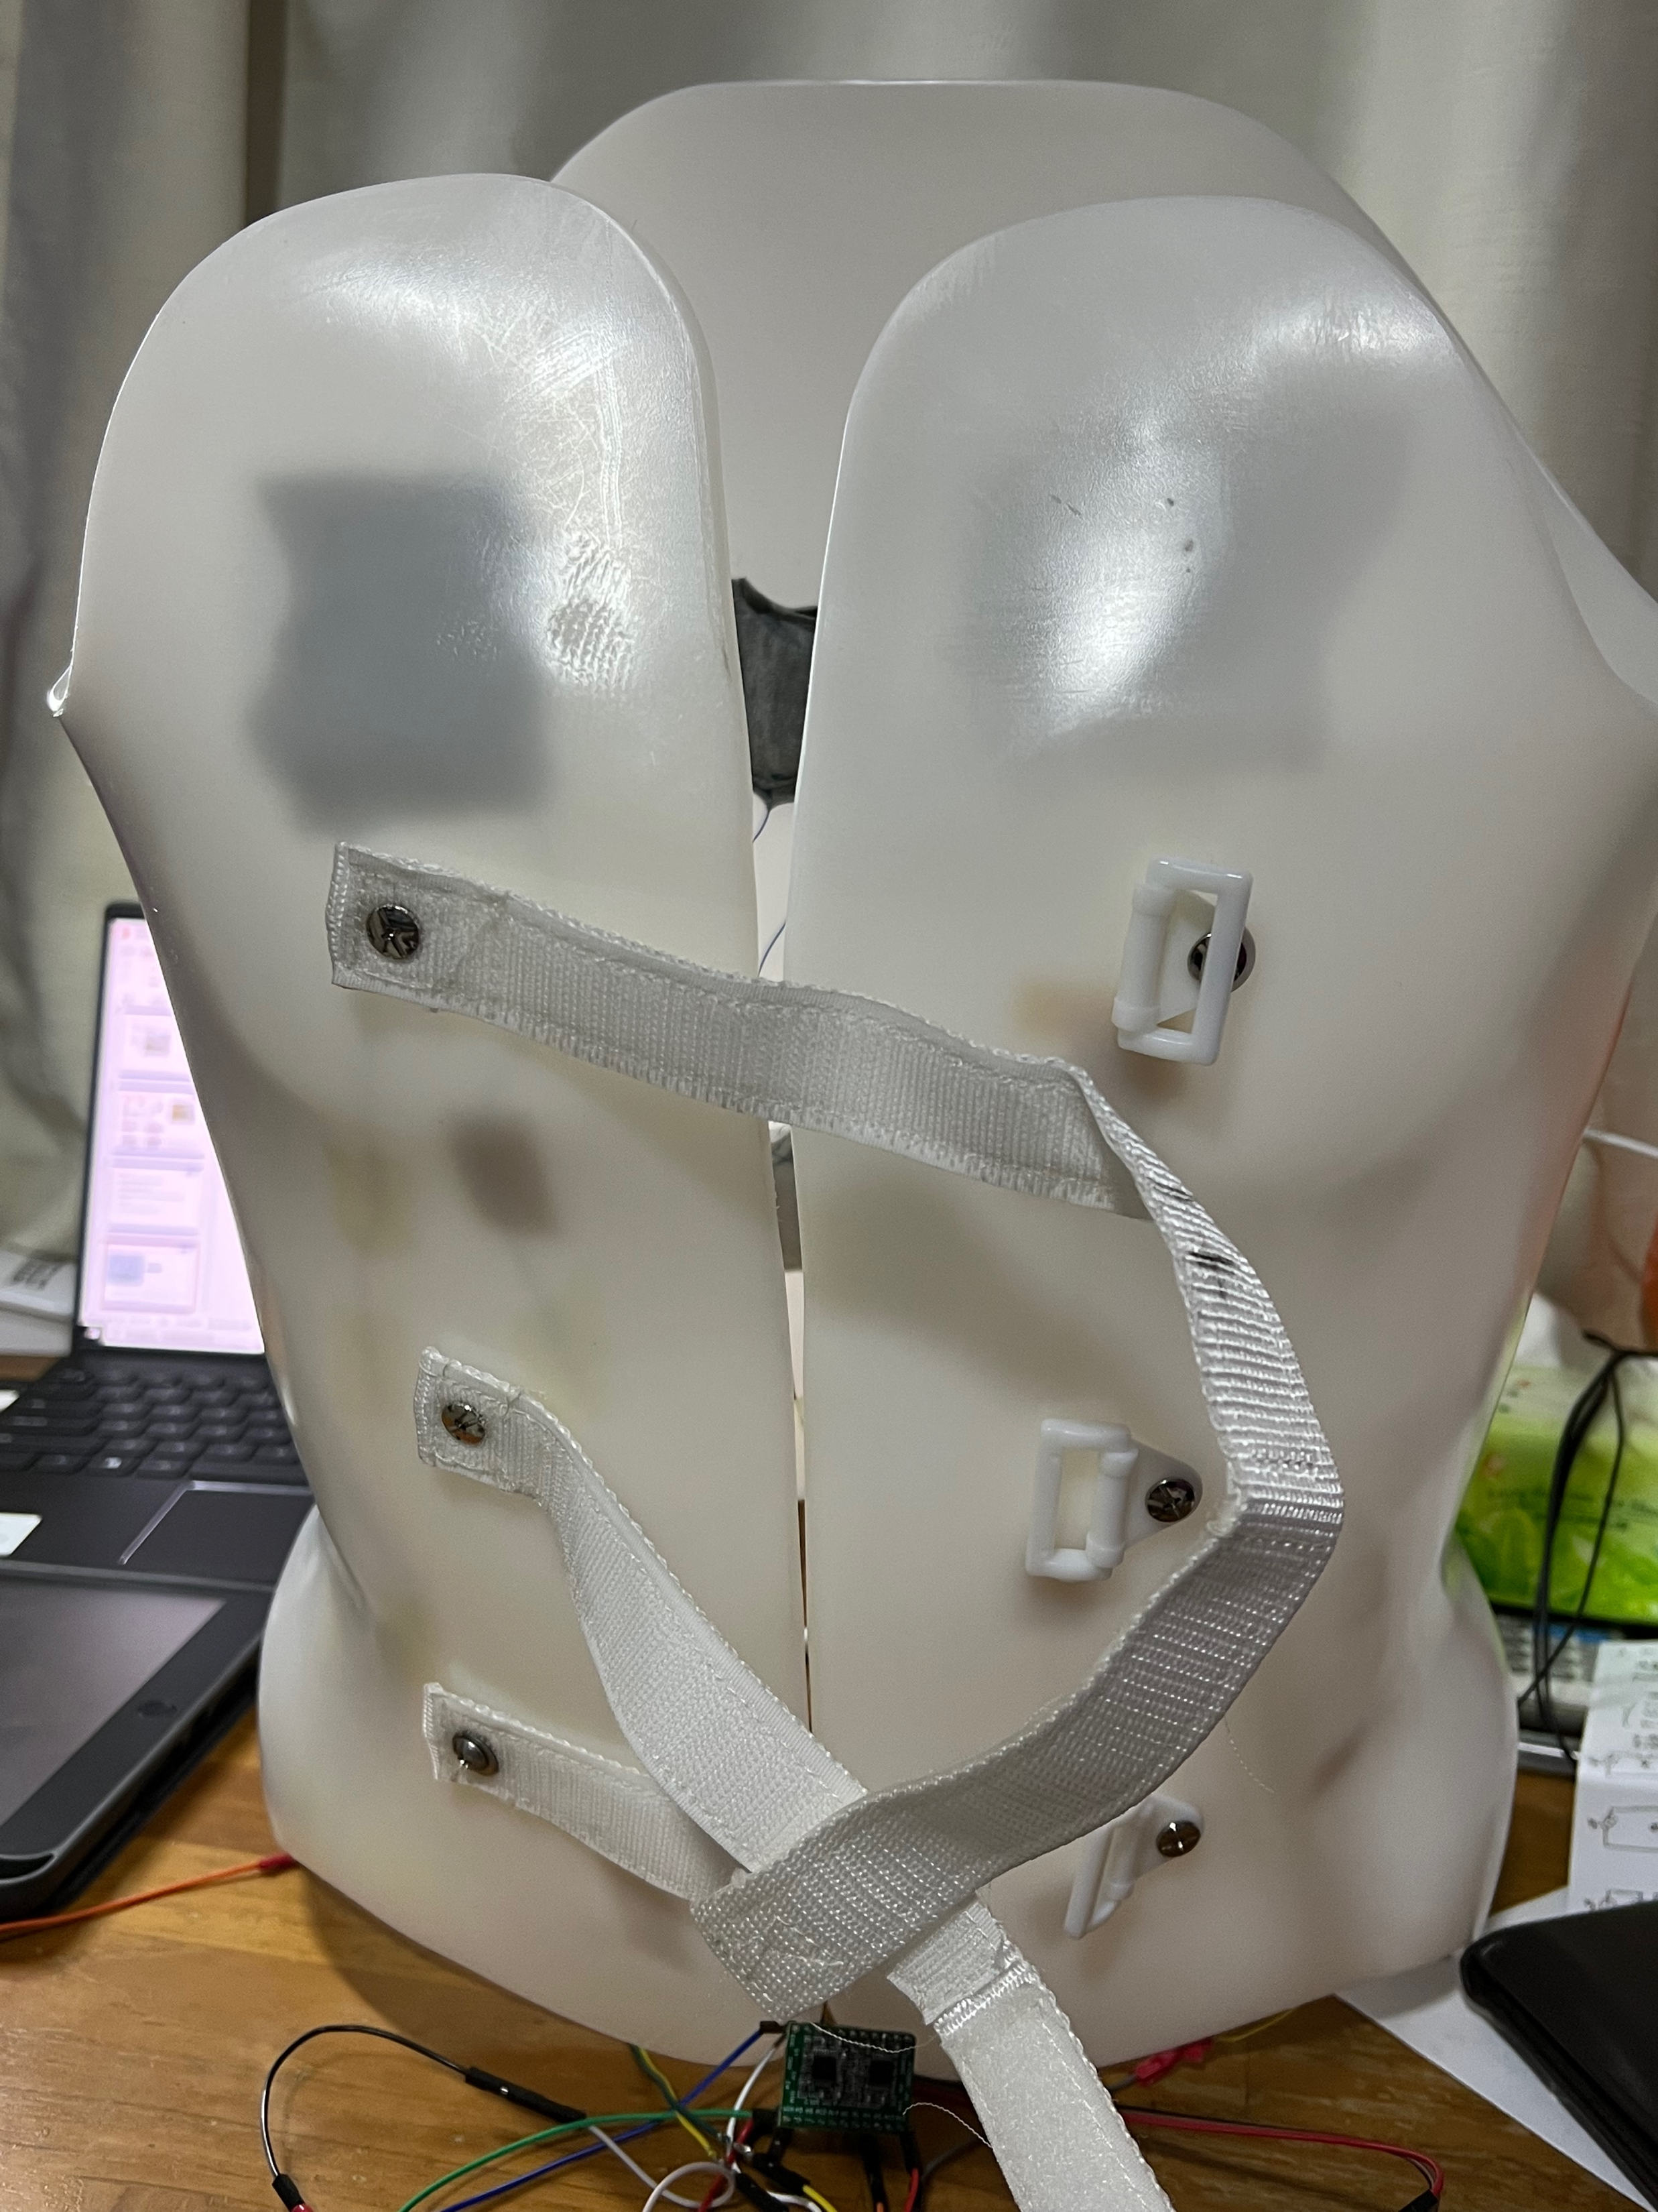
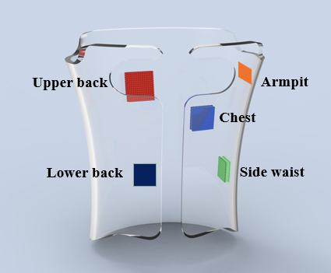
3. Sensing Distribution
a. Triboelectric Sensor
Encapsulation
INPUT
Textile
Nickle
Nitrile Rubber
EcoFlex
Nickle
Textile
GND

Slide 17
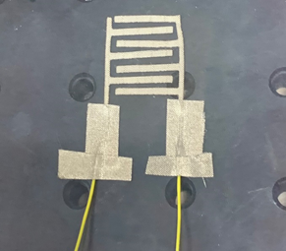
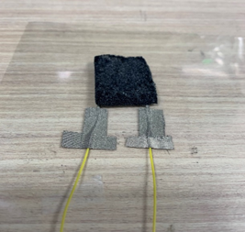
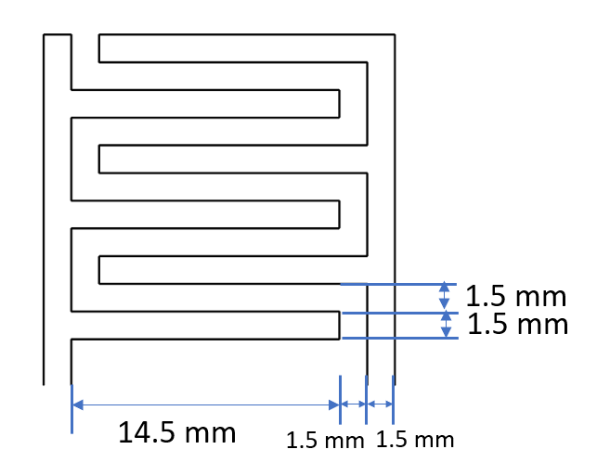
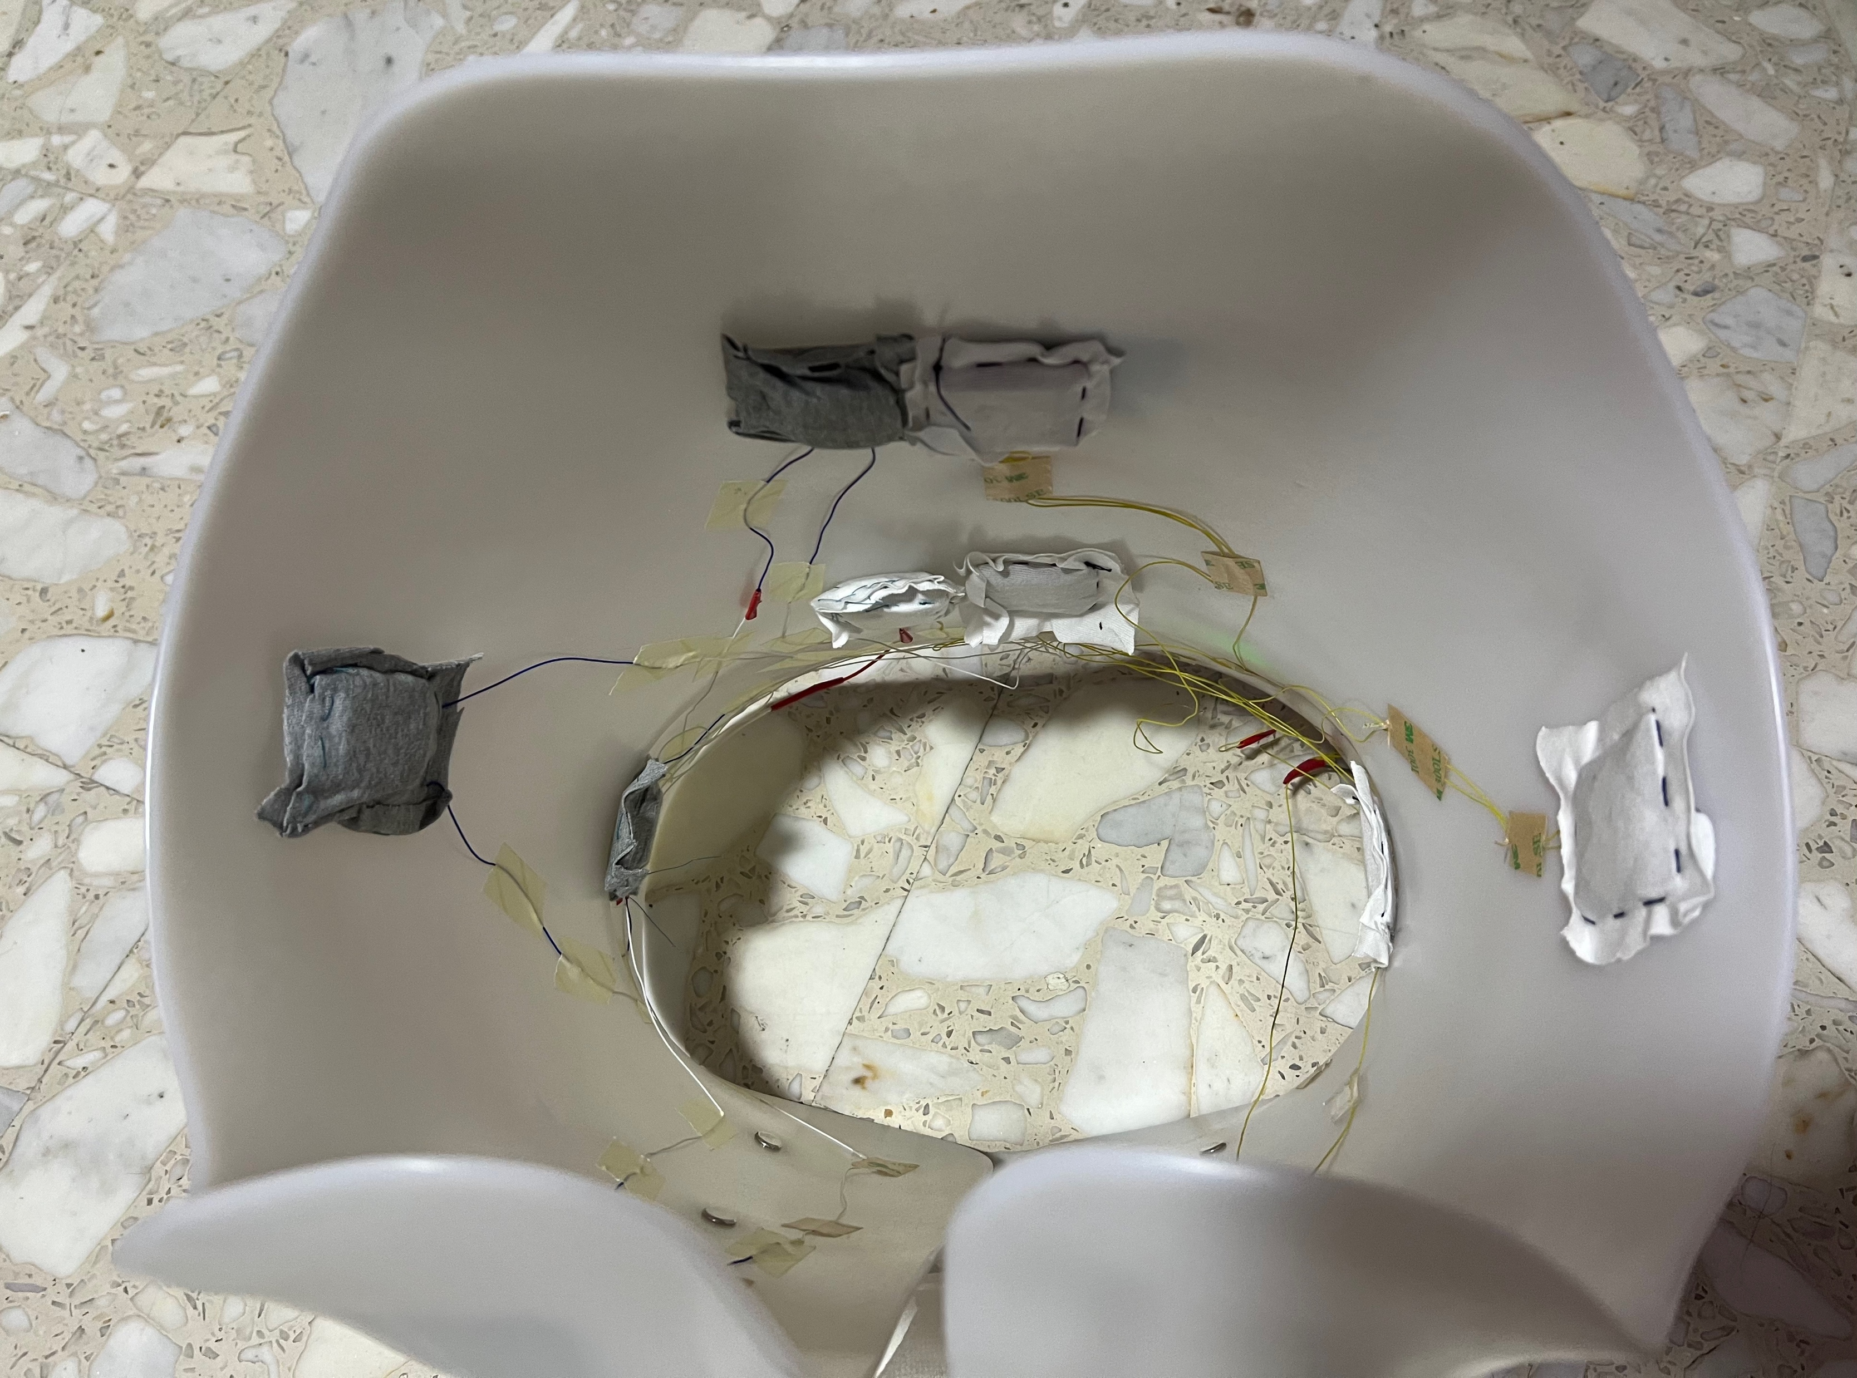
3. Sensor Distribution
b. Interdigital Electrode Sensor
However, triboelectric sensors have weak capability to detect static posture.
For improving static posture detection, another five interdigital electrode sensors [1] are added to the e-Vest.
[1] Interdigital electrode sensors are fabricated by my partner Zhou Jinfeng.

Slide 18
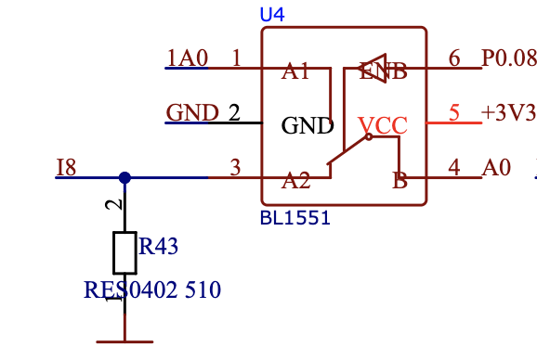
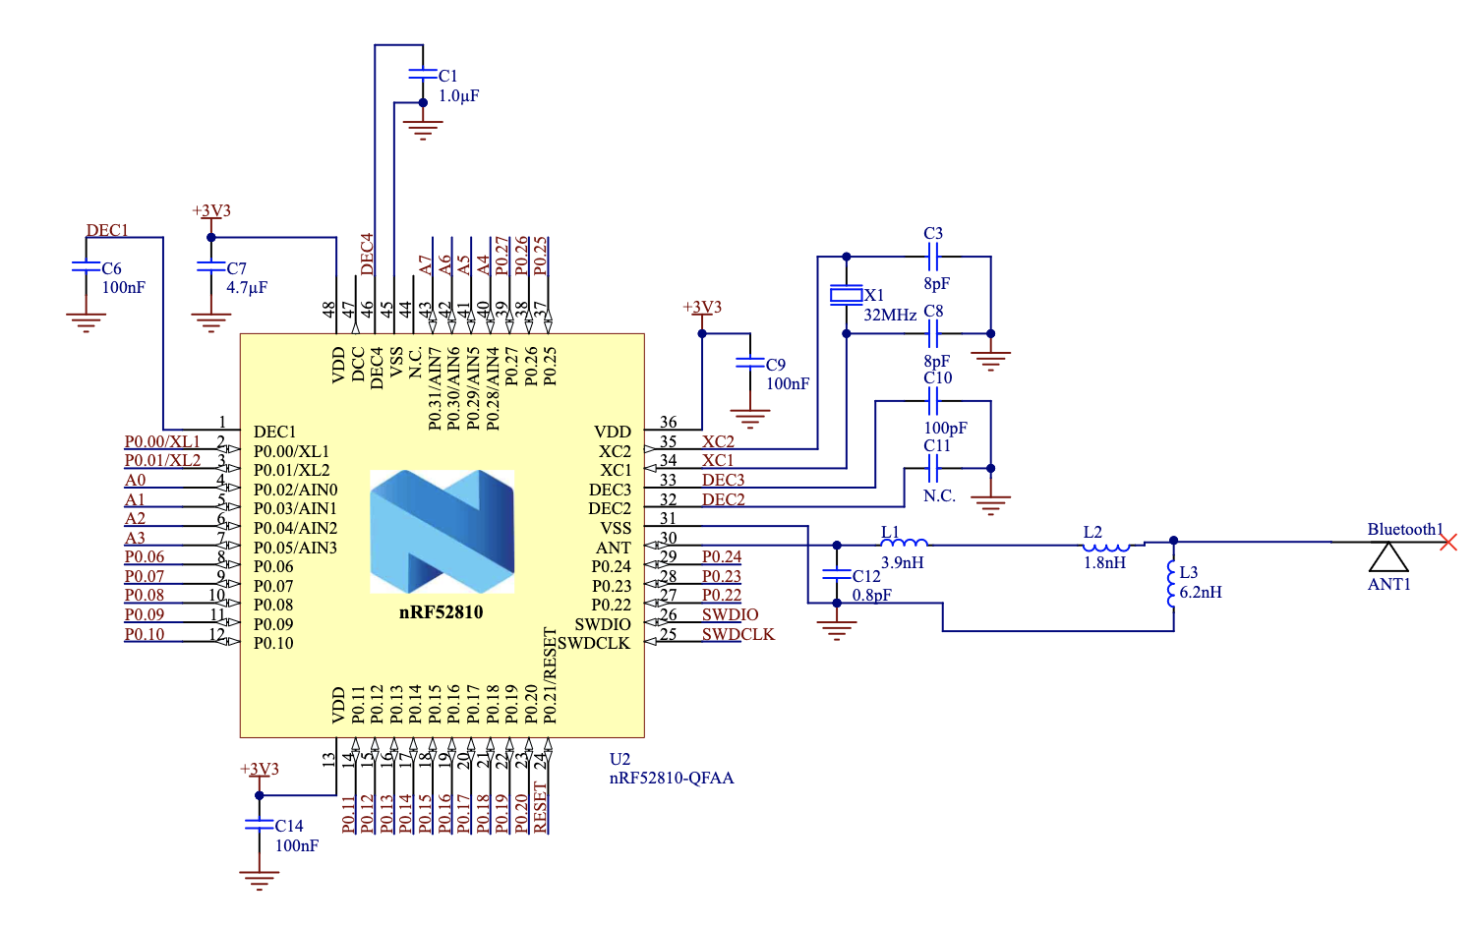
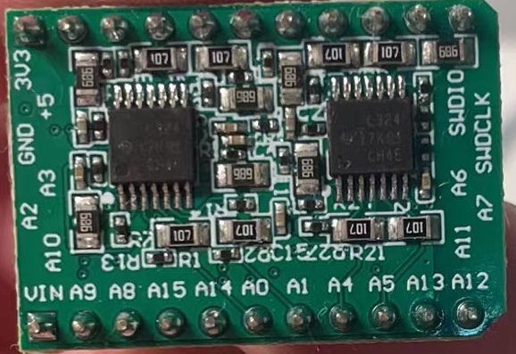
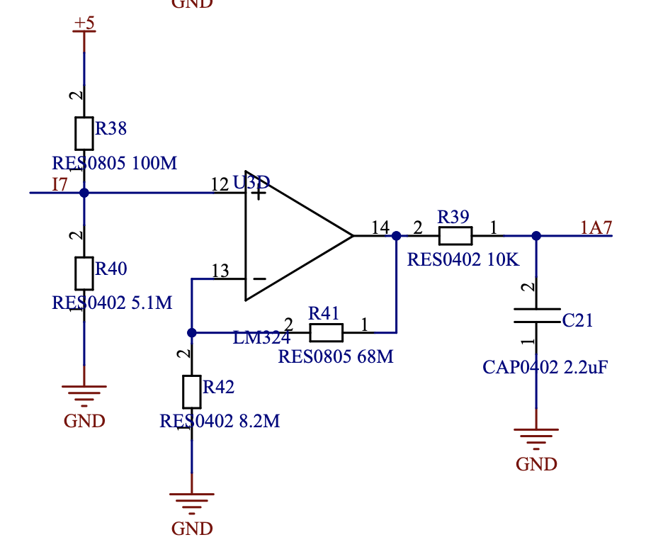
4. BLE Module
a. Signal Acquisition
The module produce 8 channels for detecting signal from triboelectric sensors directly and 8 channels for interdigital sensors via partial voltage.
[1] BLE Module is designed and fabricated by my partner Sun Wenmao.

Slide 19
4. Back-End Design

Slide 20
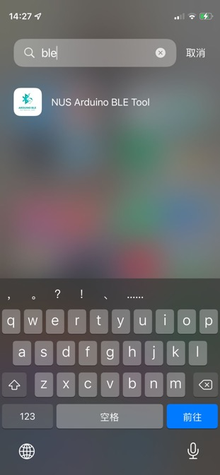
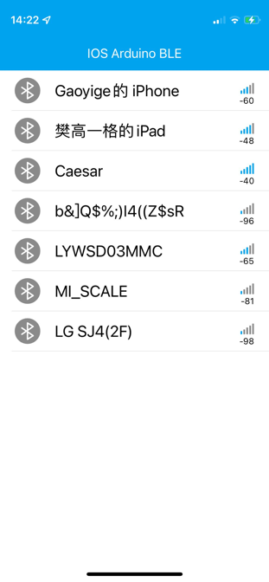
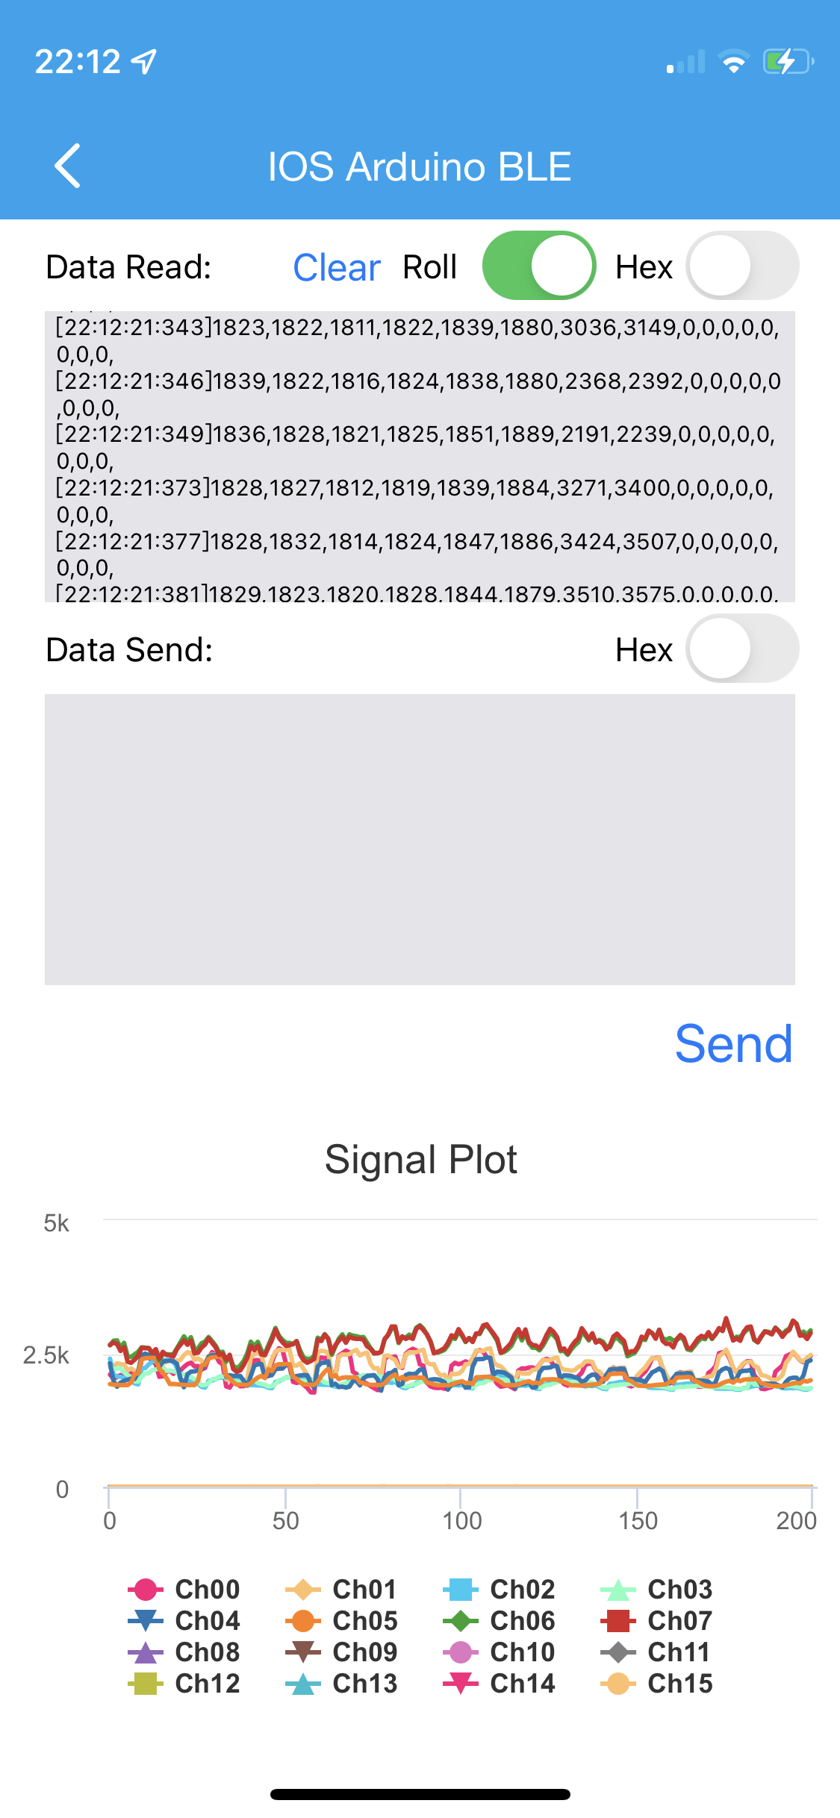


1. NUS Medical Care App
Develop an IOS app for patient to track real-time motion via BLE and update data to database through TCP/IP. And the data will be plotted on iPhone in real time.
Raw
[21:56:58:755] turn right
[21:57:00:585] sit & stand
[21:57:02:523] no motion
[21:57:04:416] run
[21:57:06:544] run
[21:57:08:435] no motion
[21:57:10:565] walk
[21:57:12:604] walk
[21:57:14:435] no motion
Raw

Slide 21
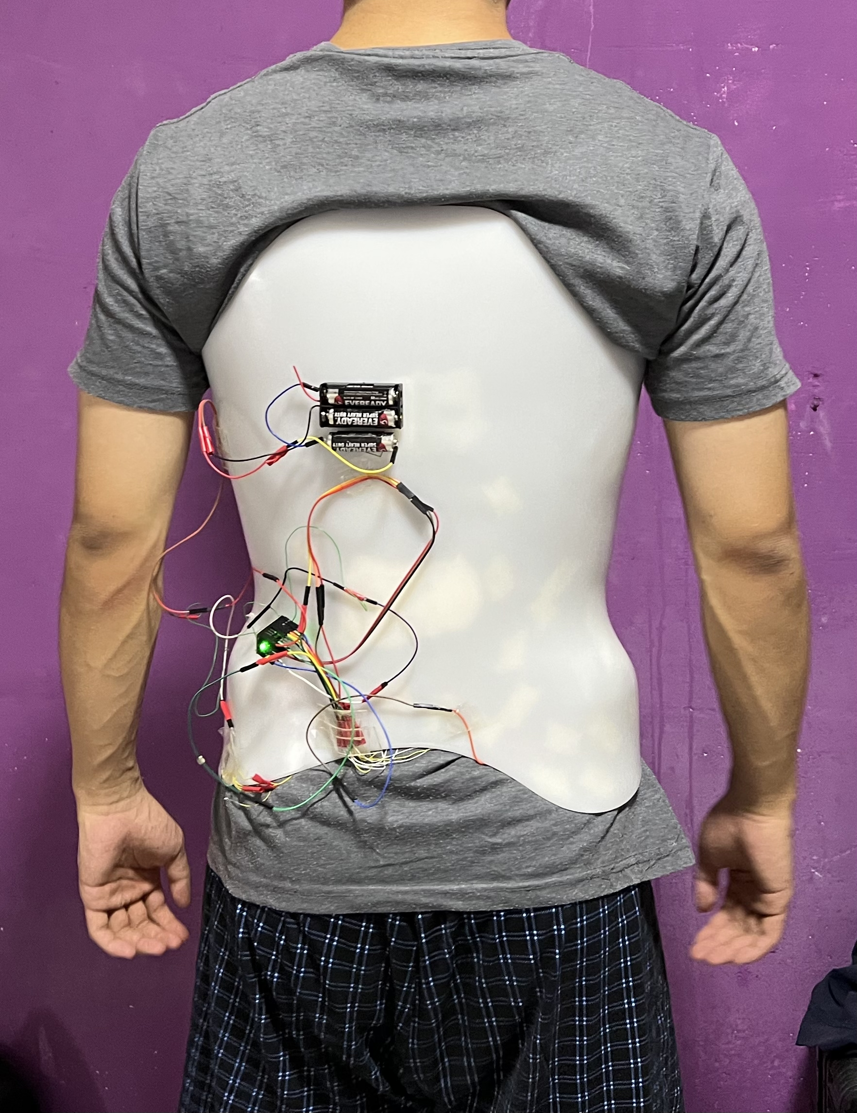
2. BLE Communication
I develop an APP on IOS platform, it can communicate with nrf52810 via BLE.
The board works as the peripheral and advertises the UUID for the central to scan and connect. When connected, it use BLEIntCharacteristic structure to send data.
The APP works as the central. When connecting the peripheral, the APP use IOS CoreBluetooth library to read the data and update the data in Firebase Database.
A real time plot window based on AAChartModel framework is implemented.
BLE
Central
Peripheral

Slide 22
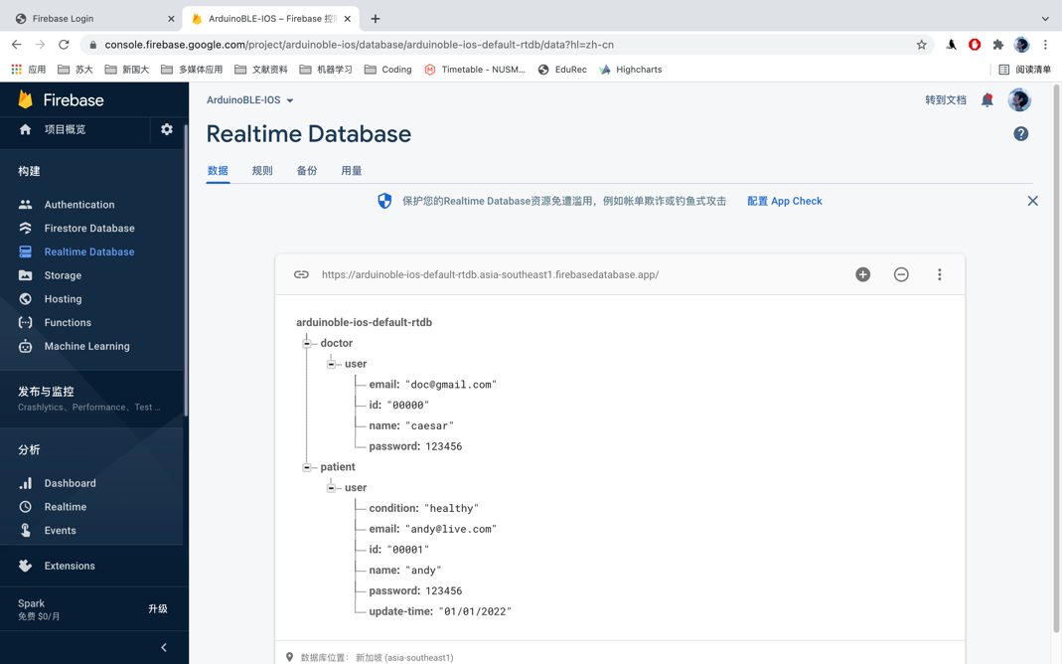
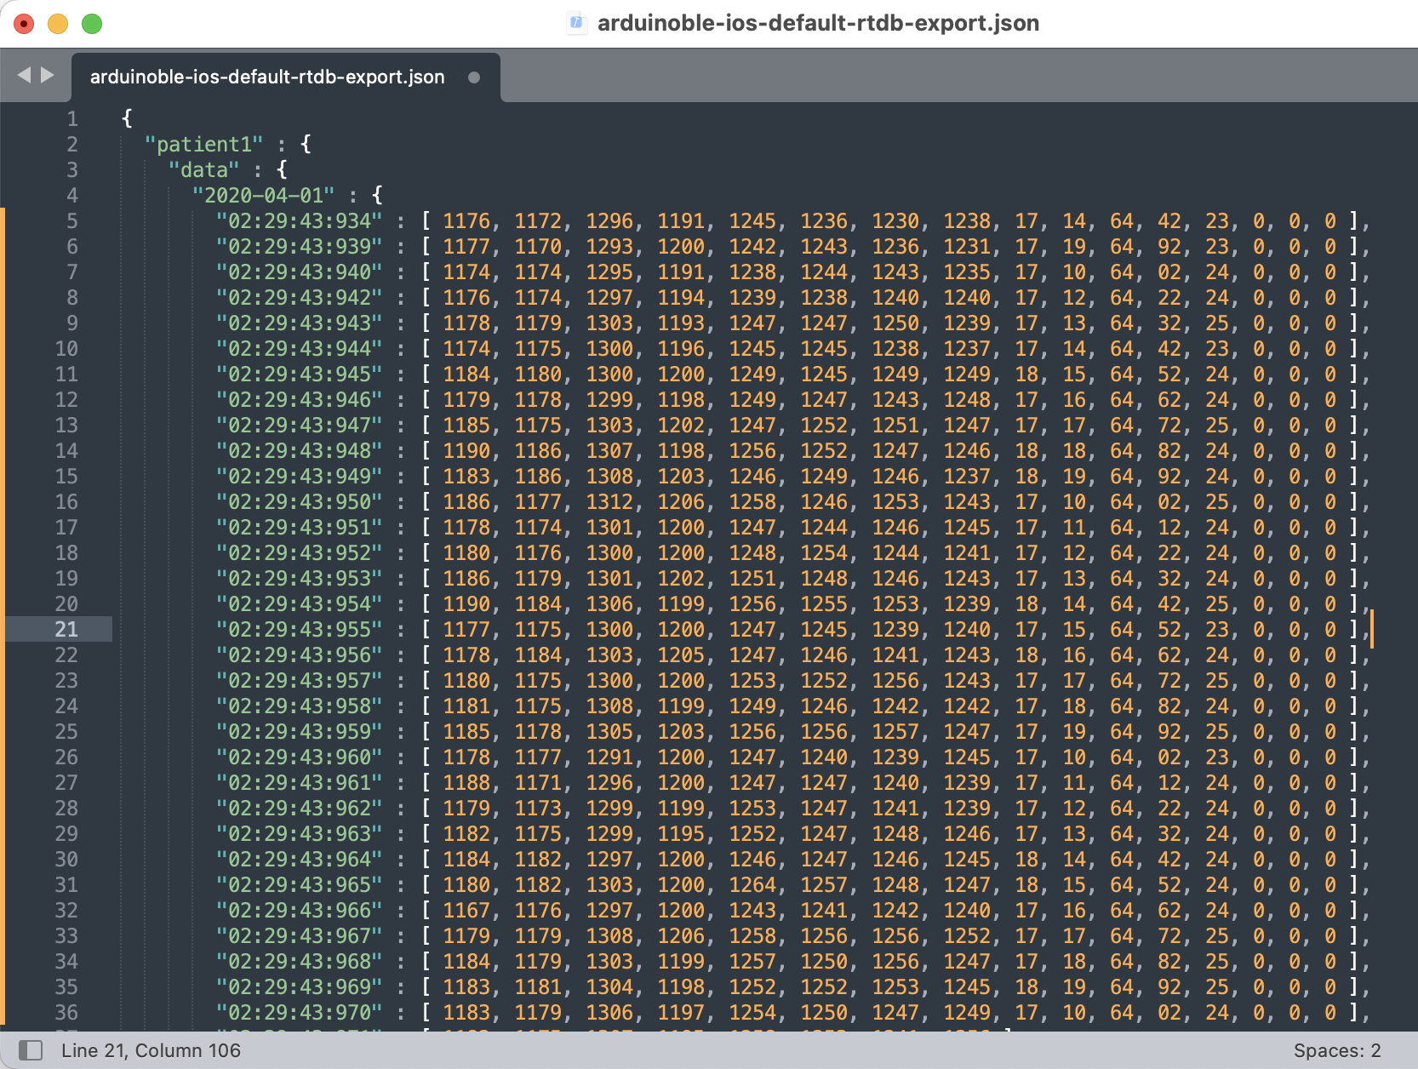
3. Firebase Database
The authentication database contains 2 tables:
1. One for doctor to analyze all his patients;
2. One for patient to view his own health information.
The data database contains the data collected from every patient.
The data for every patient is saved in .json format (a tree structure).
patientID
data
date
timestamp
[x1, x2, x3, … x16]
information
name
email
etc.

Slide 23
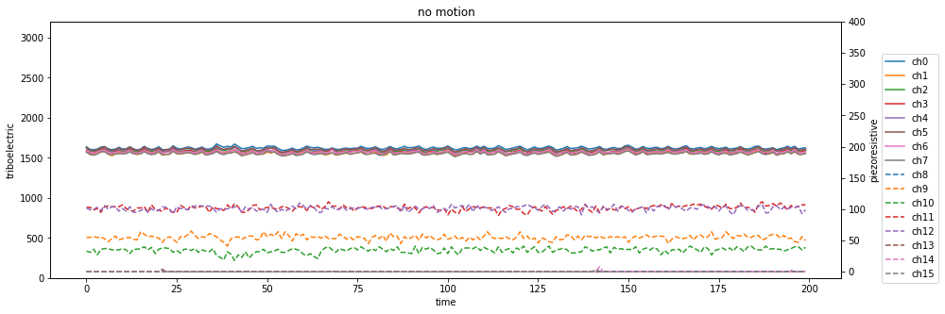
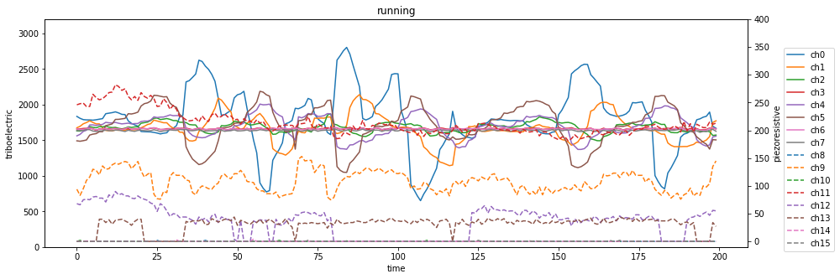
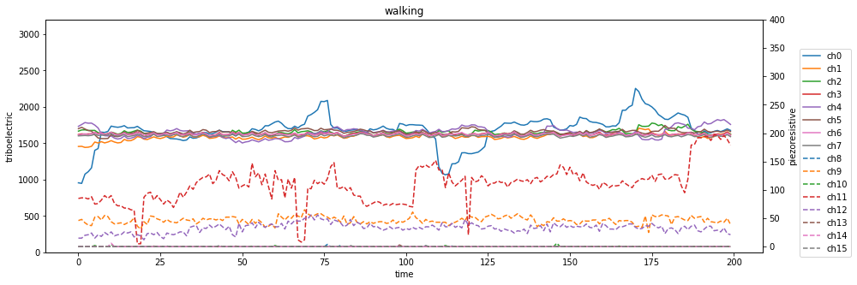
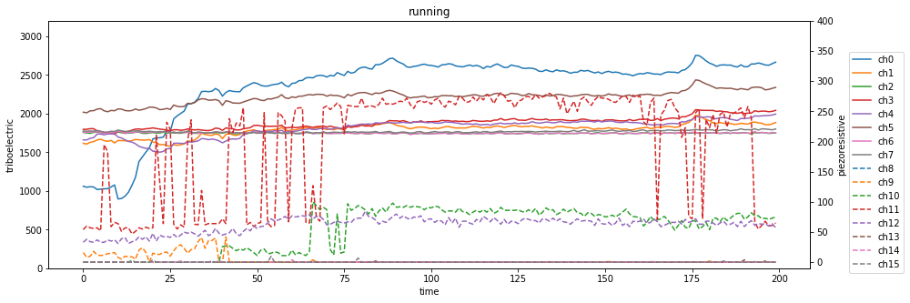
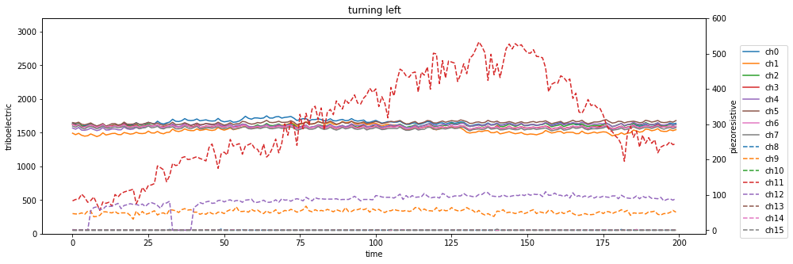
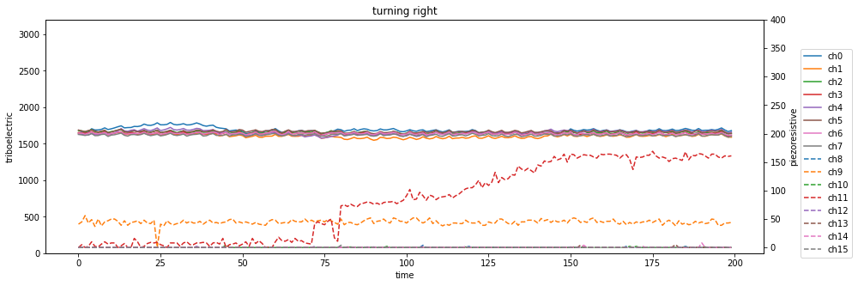
4. Data Acquisition
Owing to the difference communication between wireless BLE and wired serial port, I developed a python program for collecting data of 6 postures (no motion, walking, running, sitting, turning left and turning right).
Each posture contains 200 group for training and 50 group for testing.

Slide 24
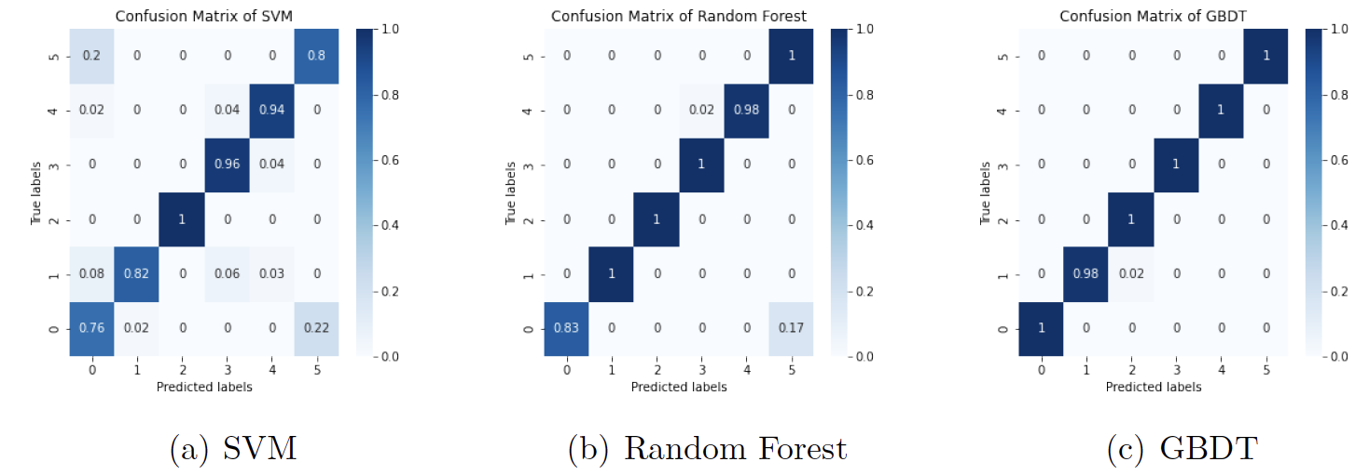
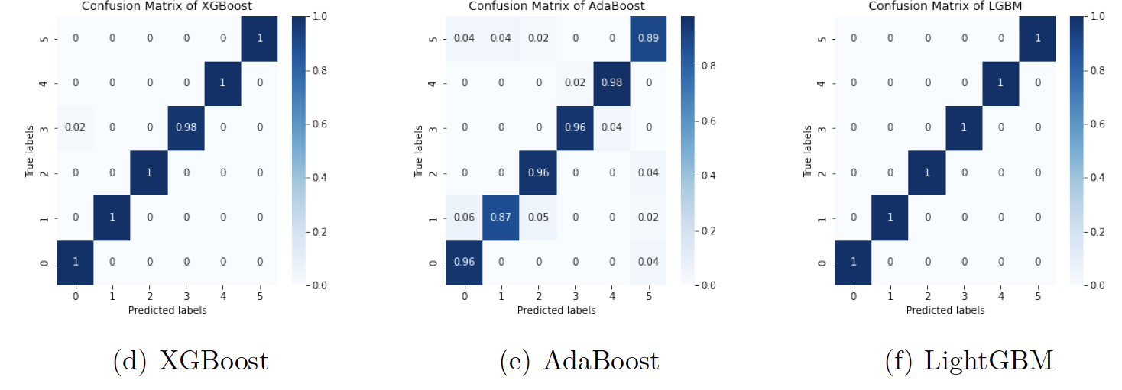
5. Machine Learning
b. Confusion Matrix

Slide 25
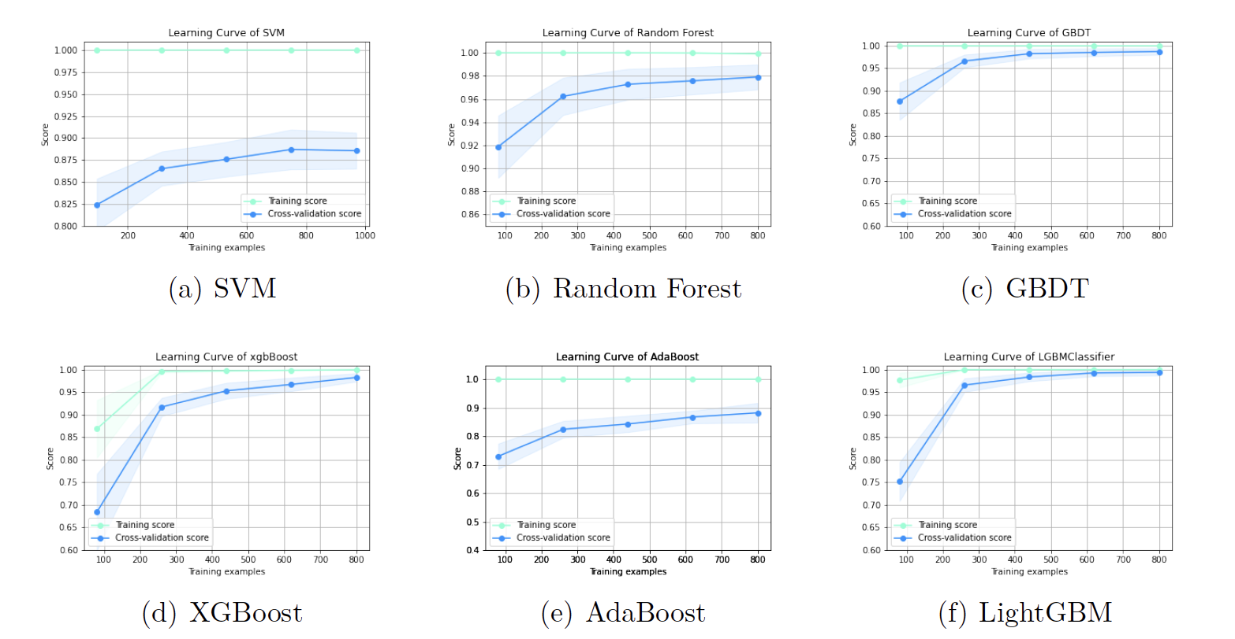
5. Machine Learning
c. Learning Curve

Slide 26
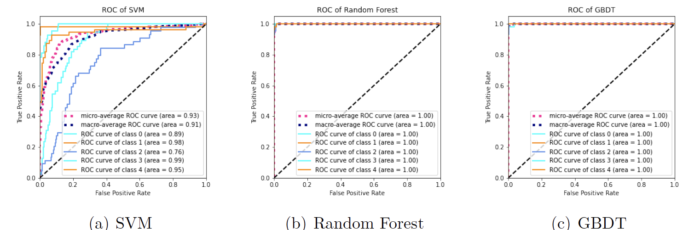
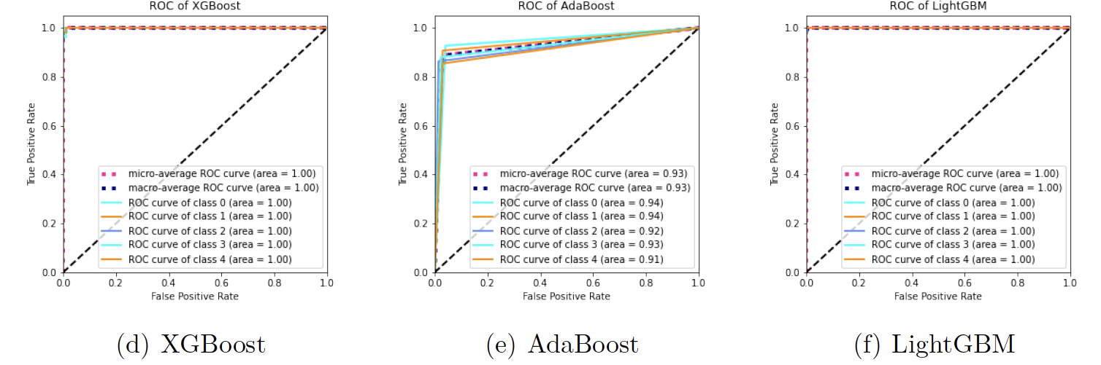
5. Machine Learning
d. ROC Curve

Slide 27
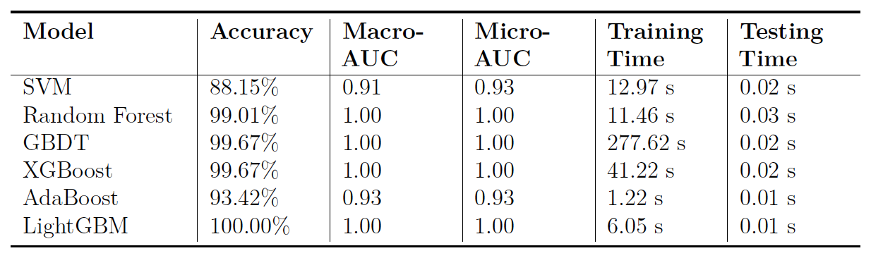


5. Machine Learning
e. Summary
LightGBM model has the best performance in accuracy and converging rate. we generated the model “lgbm.model” by dumping all the parameters.
IOS platform offers API for machine learning via coreML. Thus, I developed a program for converting it into ”lgbm.mlmodel” format and implement real time recognition in IOS app.

Slide 28
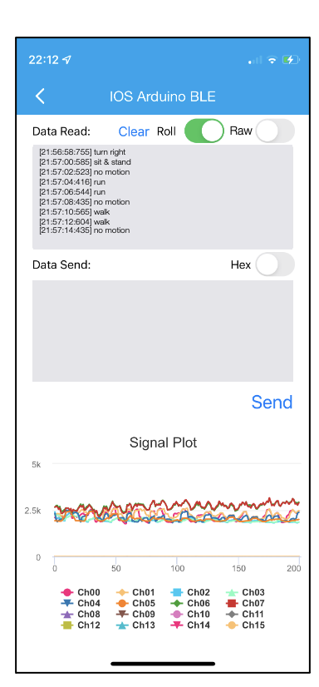
5. Machine Learning
f. Machine Learning on iPhone
An iPhone can keep collecting data via BLE, visualizing the data, and recognizing the postures with the data at the same time because of the multi-kernel architecture in CPU.
The recognition result will be sent to database as well as the raw data.

Slide 29
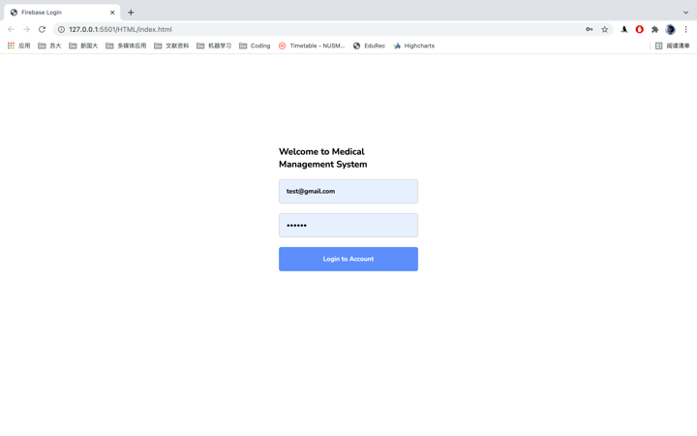

6. Medical Auxiliary Analysis Platform
Deployed a web page based on Tomcat container in personal server. The back-end system in server is based on Spring framework. The fond-end interface contains Html+CSS+JavaScript.
The left web is a login interface for verifying visitors’ identities.
The right is an auxiliary analysis platform for visualizing the statistic data of patients.

Slide 30
5. Conclusions

Slide 31
Conclusions
In this project, a complementary medical treatment system was successfully constructed based on self-made wearable triboelectric and interdigital sensors.
First, a polyethylene-based, flexible, lightweight, low-cost, and comfortable lower powered e-vest was manufactured and tested.
Next, a signal acquisition system was established, which helped the successful conversion from analog signals to digital signals and enabled wireless communication between e-vest and iPhone to be implemented.
On this basis, the combination of AI algorithm and wearable sensor was explored, and the time-series data from the sensor was successfully processed.
Additionally, a communication between iPhone and database is connected through TCP/IP, which realize the real-time data update.
Lastly, a web page based on the database for visualization is implemented.
After all. this system we designed provides a closed-loop solution for monitoring, therapy, and diagnosis for adolescent scoliosis patients and doctors.

Slide 32
Thank you! Q&A

